Slide 1
Linux Command Line and GitHub

Slide 2
We will be using a linux terminal often in this class please download or print a "cheat sheet" if you are unfamiliar with linux commands.
cheat sheet
To open a terminal you can press ctrl + alt + T
Or you can search for terminal in your menu. (I prefer the hotkey)

Slide 3
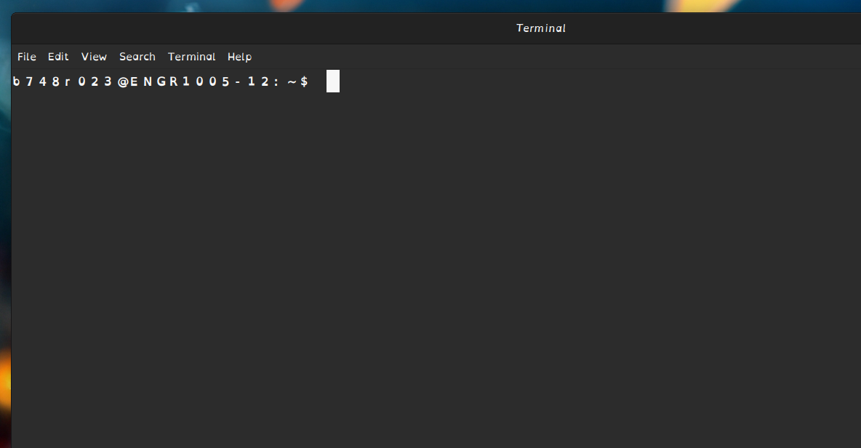

Navigating your Directory
This is the current Directory (file) you're in

Slide 4
To change directory:
Type cd followed by the directory name you wish to use:
Ex: cd Desktop
Pressing Tab will autocomplete
Double dots ".." mean previous directory
Single dot "." means the current directory

Slide 5
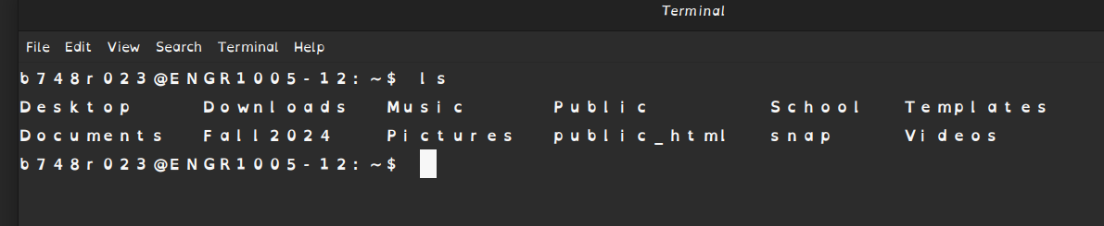
Viewing Directory Contents
To view the contents of a directory you can either type
dir – works for Windows and some versions of linux
ls – this always works for linux

Slide 6
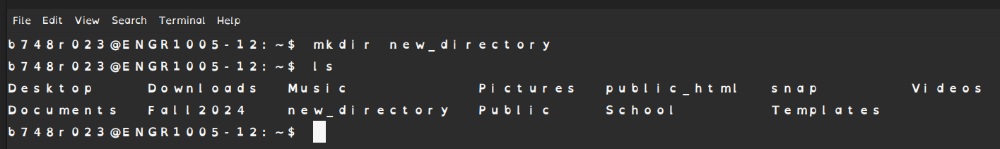


I recommend you create a folder you will keep all of your labs in.
To make a new directory in linux type
mkdir directory_name_without_spaces

Slide 7
To Clear your terminal screen type clear
There are several more commands you can used, deleting, viewing hidden files, viewing permissions, and more.

Slide 8
Create a Github Account
Join GitHub · GitHub
Use whatever Email you want to log in, you can always link your school email later
Use a professional username, this will be seen by future employeers.

Slide 9
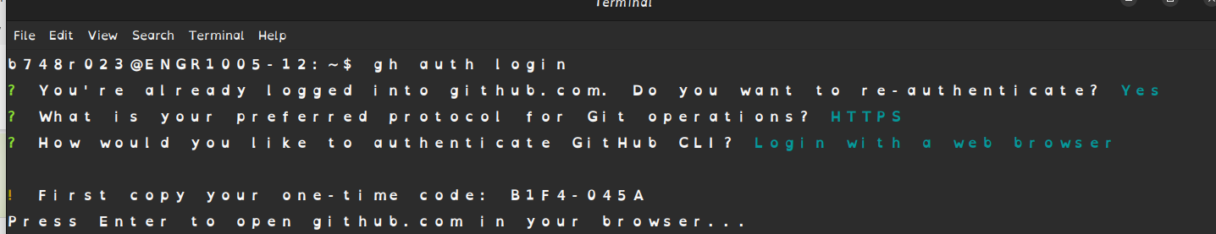
Open a terminal and authorize github
Type gh auth login
You should be able to hit enter 3 times to get to this state.
Be sure you are selecting HTTPS, Login with web browser, and then enter
Ignore the part where my screen says I am already logged in, yours won't show that

Slide 10
A browser window will open to GitHub
Follow the prompts to log in and
Type the code given from your terminal into the browser field that requests it.
And now your computer is ready to communicate with your GitHub account.

Slide 11
Accept Lab Assignment
Find labs on the Wiki here
Find the link for the lab section you are in and click on it
When prompted sign in to your github account
After redirect click accept this assignment
Wait a minute and then refresh the page

Slide 12
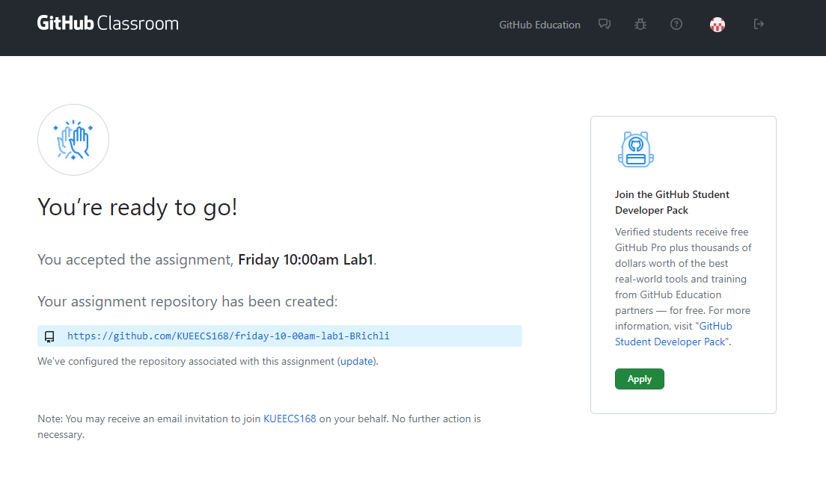
After Refresh Click the Link

Slide 13
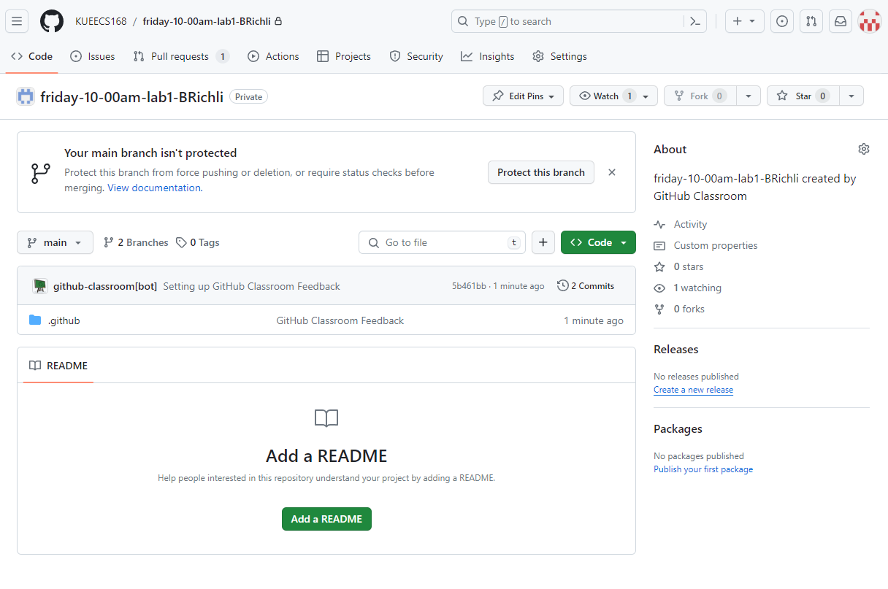
This will be your github repository for this assignment

Slide 14
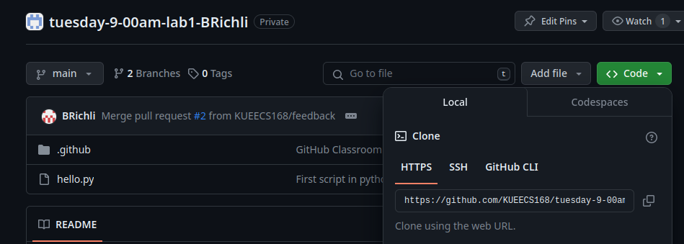
Click Code and Copy the Link Provided

Slide 15
Now we need to clone the lab repository
Open a Terminal and either create a folder you will keep all of your labs in, or navigate to one that you have previously created.
Type in the command: gh repo clone URL_you_copied
The URL is the one you just copied. Terminal doesn't use hotkeys like ctrl + v. So you will need to right click and select paste.

Slide 16
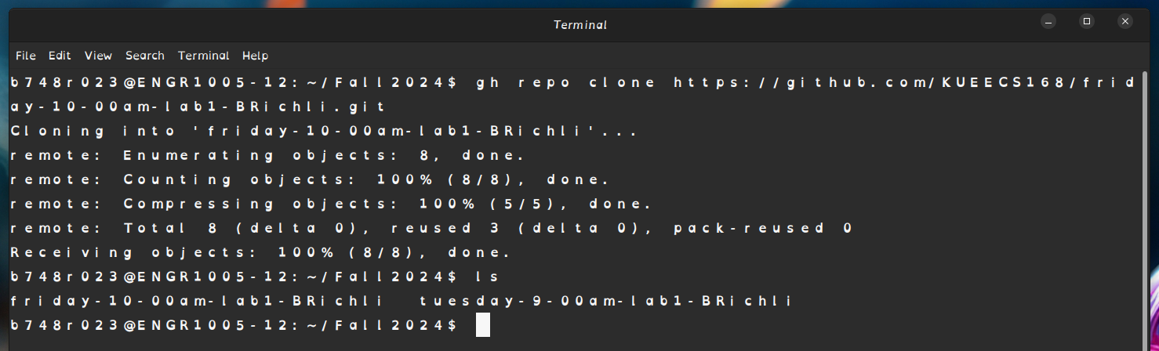

What it looks like for me
The command to create the repository
The folder I want to create my new repository file in
Notice that it has created a folder for my repository!

Slide 17
Navigate to the new repository directory that was created
Now we need to add a remote to our repository.
After you have navigated into this new git repository directory type:
git remote add origin URL_you_copied_again
Origin is just a name you can name your remote whatever you want, but for now use origin
If you don't have the link go back to github to copy it again.

Slide 18
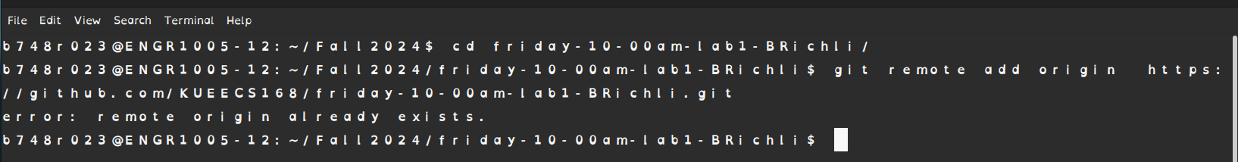
What it looks like
Changing to the directory you created
You will probably see this error too. That is Fine! If the remote already exists we don't need to create it.
Command to create the remote

Slide 19
Making your first Python file with nano
Make sure you are in the folder associated with this github repository!
Type nano hello.py
A nano text editor will create a new python file (if the file had already existed it would have opened it instead)
Delete any existing text and type: print ('hello world')
Type Ctrl + O and hit enter when prompted: This saves the file
Type Ctrl + X: This exits

Slide 20
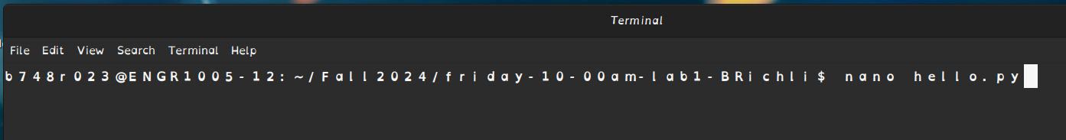
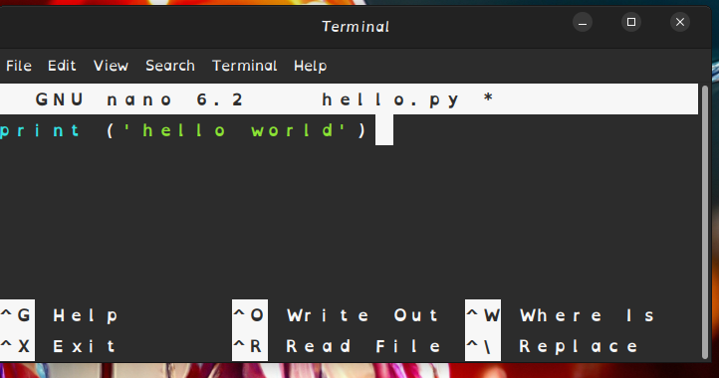
The command to create a new file and open the nano text editor
Remember to be in the Github repository

Slide 21
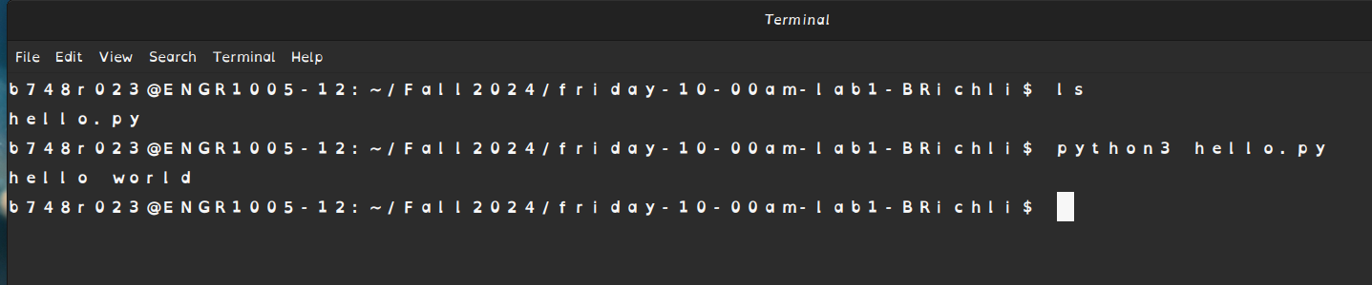
Running your code in the terminal
To make sure that your file works type: python3 hello.py
This will run your python script and you should see: hello world, printed to the terminal
We are running the command while in the directory that contains our file
The command to run our file
It worked!

Slide 22
Synching our local repository with our online repository
While we are in the repository that we want to synchronize with our online repository we will run the following commands.
git add NAME_OF_FILE_YOU_WANT_TO_SYNCH (if you use * instead of a file name it will synchronize all of your changes not just one change)
git status : this lists the status of the files you are prepared to synch
git commit –m "a short message explaining your edits"

Slide 23
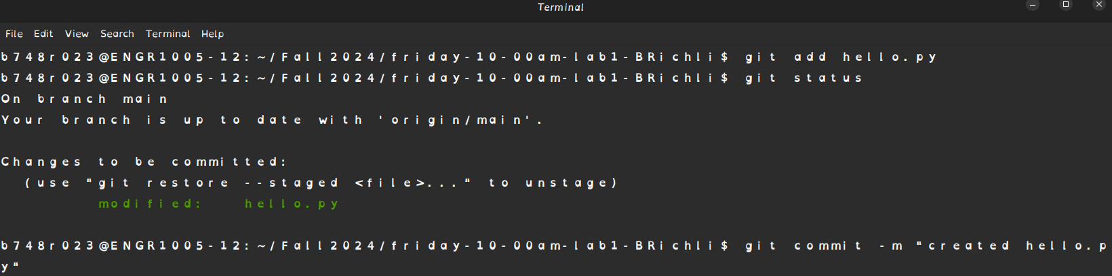
You will probably see a wall of text after you hit git commit so long as it shows something like:
1 file changed, 1 insertion(+), 3 deletions(-). You did it right.

Slide 24
Send Changes to Github
Type;
git push origin main
If you chose a different name for your remote use that name
If you get an error try typing "master" instead of "main"

Slide 25
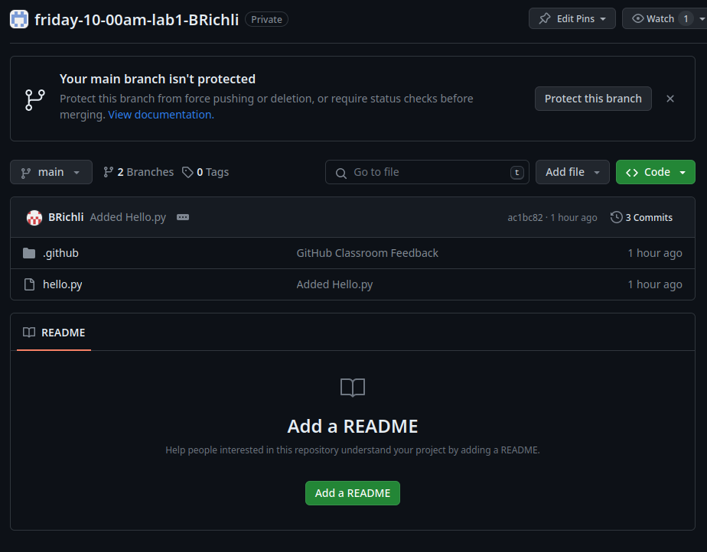
Check GitHub
Look, that's our file! We did it

Slide 26
Getting Feedback and Grades

Slide 27
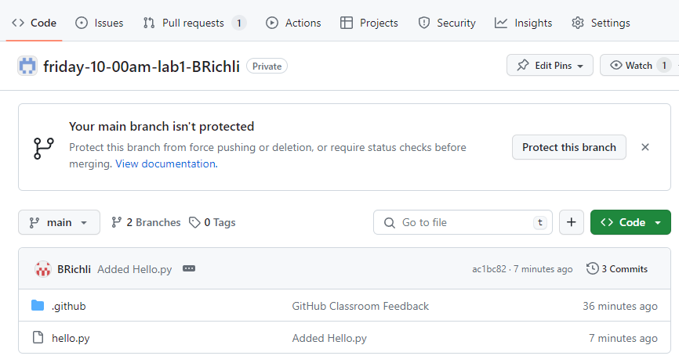
Getting Feedback and Your Grade!!
Click Pull requests

Slide 28
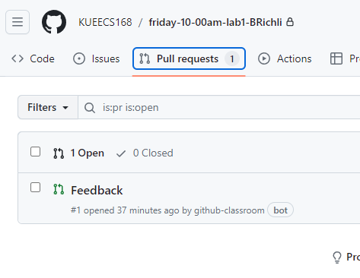
Click Feedback

Slide 29
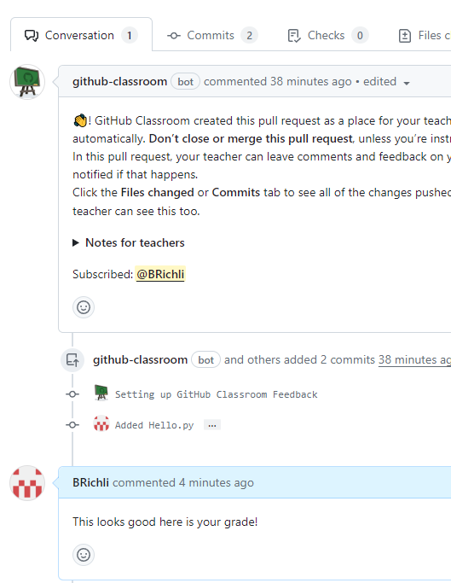
This will be a thread of feedback from me. You are free to message me about feedback too. Email is probably faster though.
This is my username, please be sure to check feedback regularly. Especially if I need you to correct issues before I commit your final grade.

Slide 30
And that is the process
Make sure every change you make to your assignment is done in the folder you created through github
Make sure you comment, commit, and push every change.
Make sure you check for my feedback.
GitHub has methods to roll back your commits to previous versions if you make a mistake. GitHub is a very important part of any programmers process. Please create your own repositories and play practice committing and pulling your changes.

Slide 31
USING IDLE

Slide 32
IDLE
You can open an IDLE shell by searching in your menu
This is a IDE (Integrated Development Environment)
You can test simple scripts, edit files, debug and more
It comes automatically with most python downloads

Slide 33
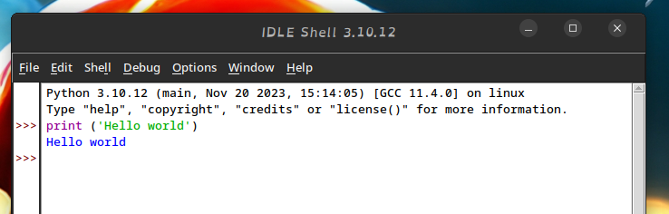
Open IDLE and run a script
Type a short script and hit enter
And it will immediately execute!

Slide 34
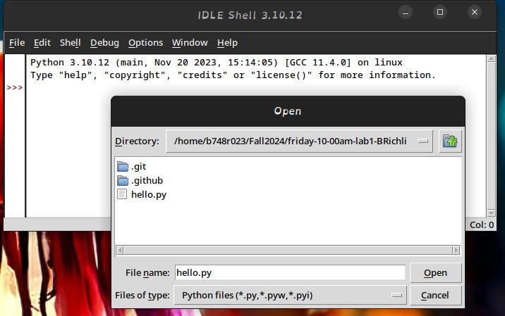
Running a File with IDLE
Click File Open, and navigate to the file you want to look at and execute.

Slide 35
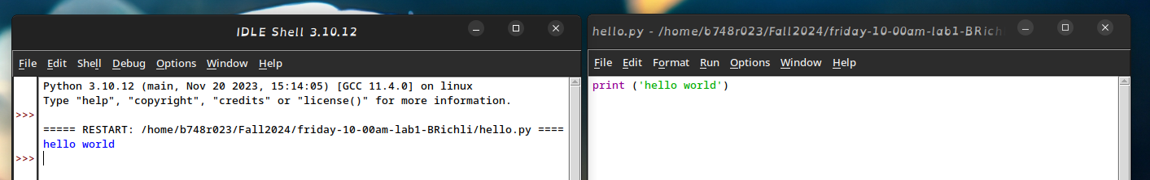
A second IDLE shell will open with the file in it
Select Run -> Run Module
The output of running should be printed to the original terminal.

Slide 36
IDLE has several features that are usefull for debuging
Inserting breakpoints in your code
Executing code line by line
Examining the values of variable at each point
And more
Documentation is at IDLE documentation
If you choose to use IDLE please take some time to familiarize yourslef with it.

Slide 37
Final Submission
In the folder with your Lab1 github repository use nano to create a new file named Lab1.py
Create a block comment at the top of the file by copying and pasting this code
''' Author: Your Name Here KUID: 1234567 Date: Date file was created Lab: lab## Last modified: Date file was most recently modified Purpose: Description of what this file does '''
Obviously change all of the info to match your details

Slide 38
Make a piece of code that prints something like this to the terminal
My name is John Gibbons. I am an EECS major. My hobbies are: Coding Board games Walking my dog Cooking Goodbye
Again make change it to match your info

Slide 39
How to do it?
We have done print statements with: print ("text here")
Every time you do a new print function it prints on a new line ex:
print("hello")
print("world")
Looks like:
hello
world

Slide 40
Alternatively
Adding the character "\n" will add a newline EX:
print("hello \nworld")
Prints:
hello
world
Notice that there is no space between \n and world.

Slide 41
To add a indent
Use the character "\t" EX:
print("\tHello")
Prints
Hello
Again no space

Slide 42
Save and test your code
Either in the command line using python3
Or in IDLE.

Slide 43
Synch GitHub
Using the, add, commit, and push
commands shown previously
Go to GitHub.com to make sure that your newly created file has been backed up or I won't be able to see it.

Slide 44
Common Print mistakes
Capitalization matters
Not closing your parenthesis
Not closing your quotes
Using a ' and a ", they must either both be ' ' or both be " "

